Slide 1
Real-time Object Tracking & Face Detection
References: http://www.slideshare.net/VanyaVabrina/real-time-object-tracking

Slide 2
Outline
Object Detection
Object Tracking
Face Detection
Object tracking using OpenImaj
Face Detection using OpenImaj

Slide 3
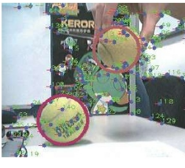
Object Detection
Detect a particular object in an Image

Slide 4
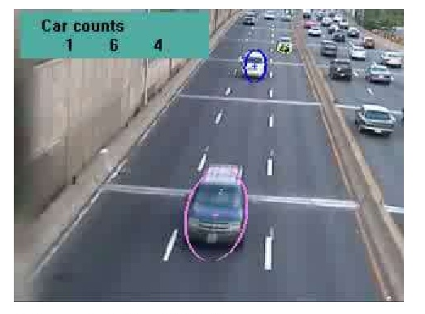
Object Tracking
To track an Object (or multiple objects) over sequence of images

Slide 5
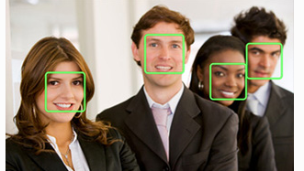
Face Detection
Identifying the human faces in digital Image

Slide 6
Application: Traffic Information

Slide 7
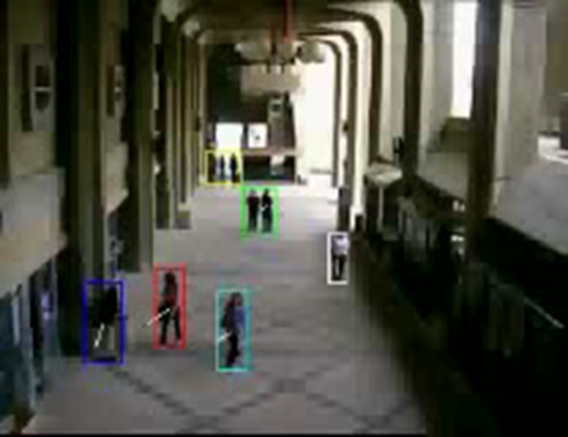
Application: Surveillance

Slide 8
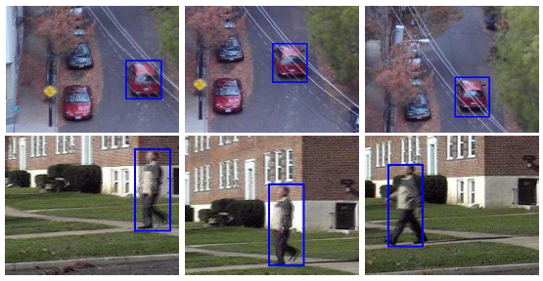
Object Tracking Approach
In a sequence of frames in a video, an object is in motion, if it is changing its location with respect to its background
keeping tracks of that moving object in video sequence i.e. position of moving object at certain time etc.

Slide 9
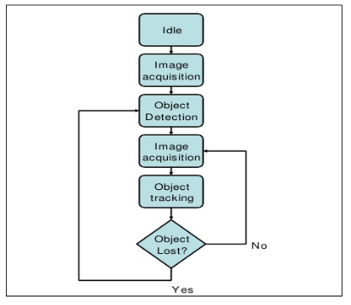
Object Tracking: Flow Chart

Slide 10
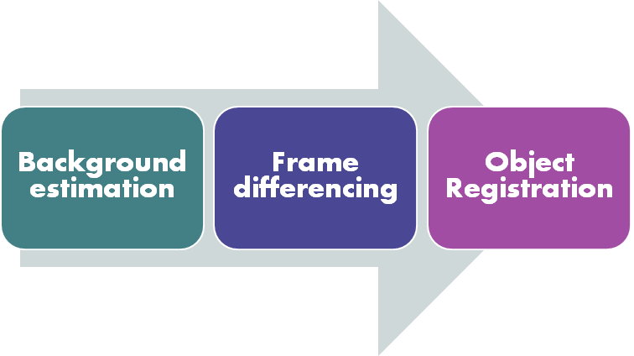
Morphology Based Object Tracking Method

Slide 11
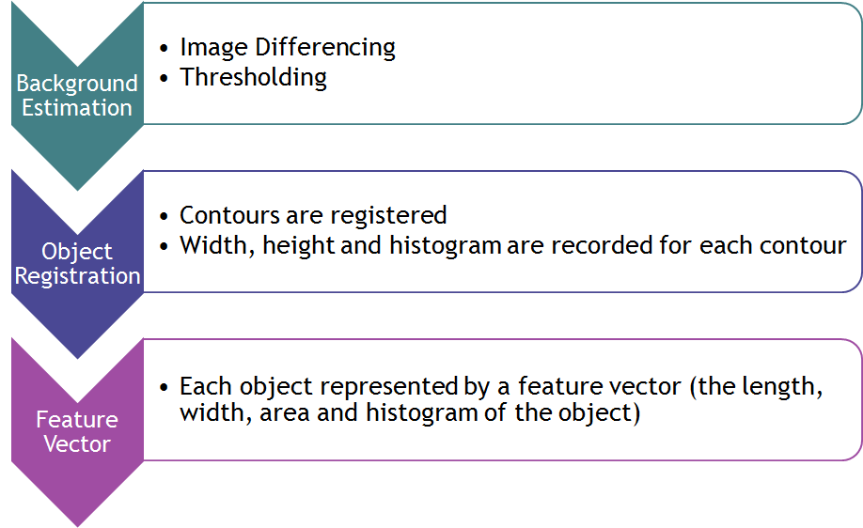
Morphology Based Object Tracking Method

Slide 12
Morphology Based Object Tracking Method
Advantages:
Can Track Multiple objects: Objects are registered based on their anatomy
Helpful for Object Merging
Draw Backs:
Object registration: complex and slow process
For multiple object registration per frame: more complex

Slide 13
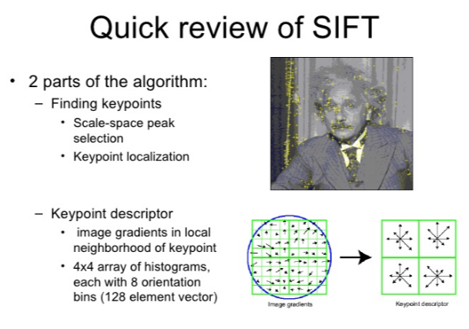

Slide 14
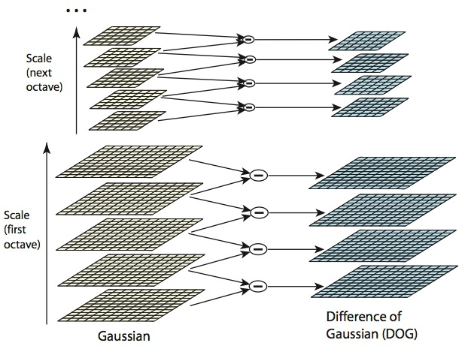
Feature Model: SIFT DOG (Difference of Gaussian)

Slide 15
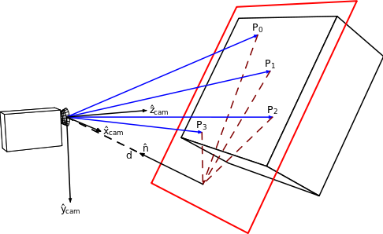
Homography Estimation
In the field of computer vision, any two images of the same planar surface in space are related by a homography.
This has many practical applications, such as image rectification, image registration, or computation of camera motion—rotation and translation—between two images.

Slide 16
Implementation – Feature Model for Tracking
Save the model which needs to be tracked

Slide 17
Implementation – DoG SIFT Model

Slide 18
Implementation - Tracking
Once the model is saved, finds the matching features from sequence of images

Slide 19
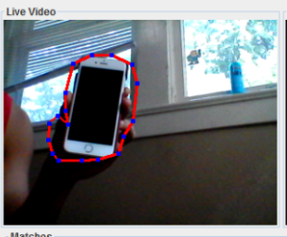
Running Tracking System: Step 1: Object Registration
Select the object to track by drawing boundary
Press ‘C’ to save model

Slide 20
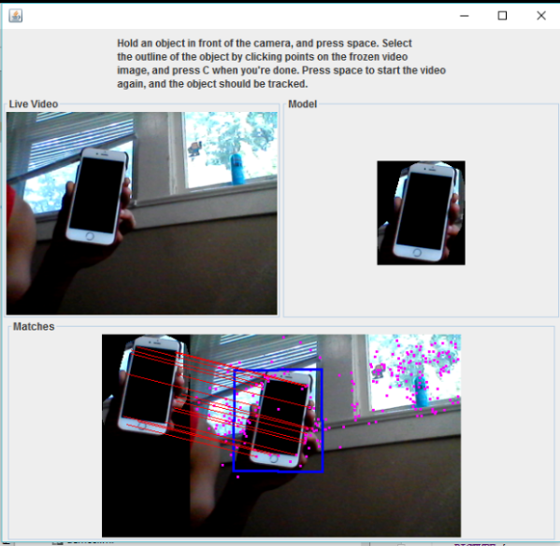
Running Tracking System: Step 2: Real-Time Object Tracking
A rectangle appears around the tracked object

Slide 21
Face Detection
HaarCascadeDetector d = new HaarCascadeDetector(100);
final List<DetectedFace> faces = this.d.detectFaces( Transforms.calculateIntensityNTSC(frame));
for (final DetectedFace face : faces) { final Shape transBounds = face.getBounds(); final MBFImageRenderer renderer = frame.createRenderer(); renderer.drawPolygon(transBounds.asPolygon(), RGBColour.RED); }

Slide 22
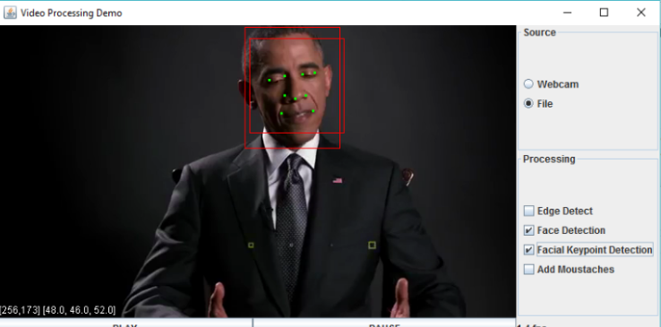
Face Detection

